Slide 1

Plumbers & Steamfitters Local 486
May 13th 2019

Slide 2
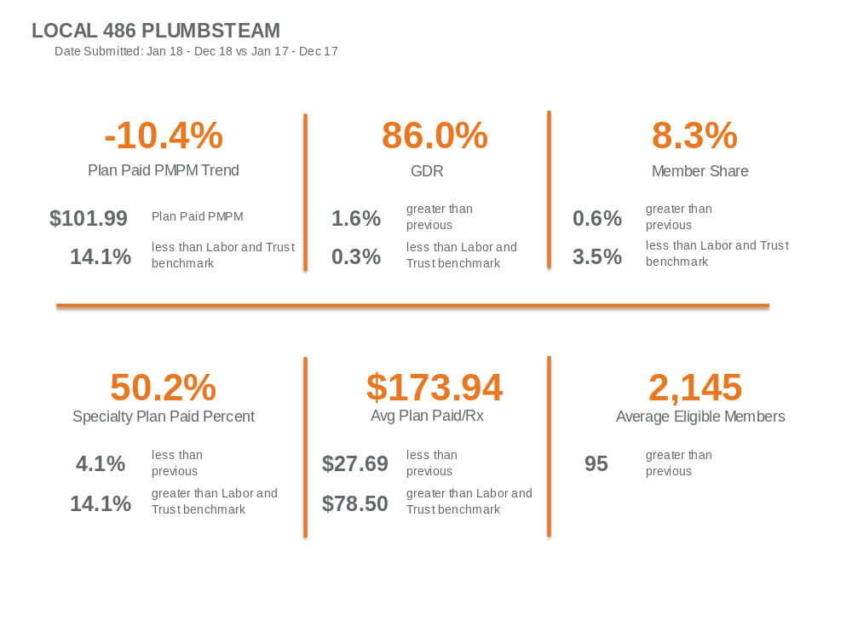

Slide 3
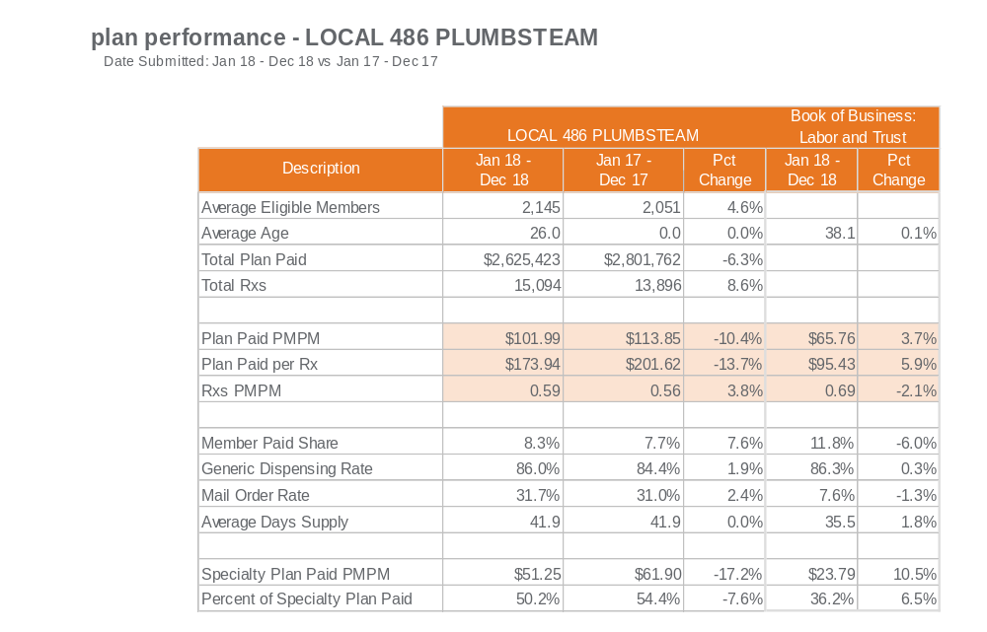

Slide 4
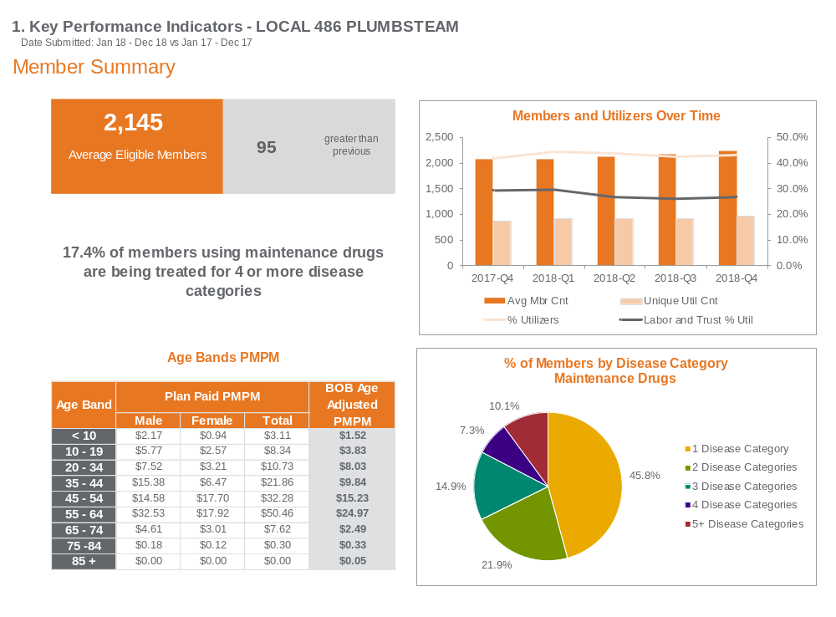

Slide 5
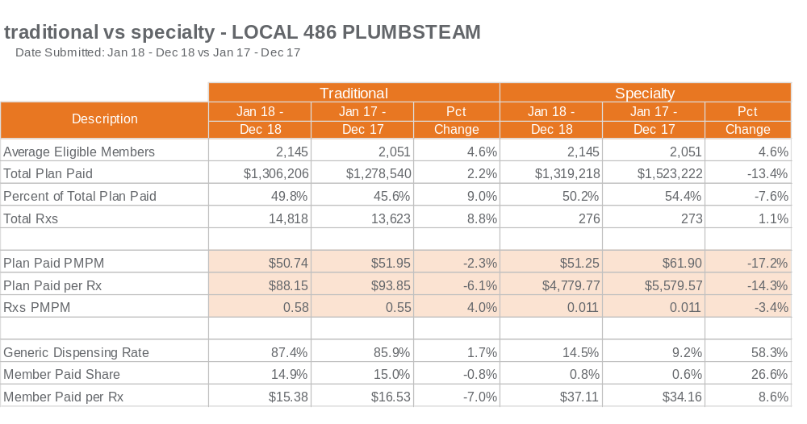

Slide 6
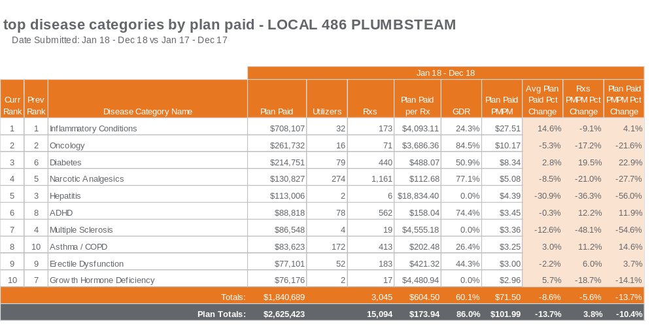

Slide 7
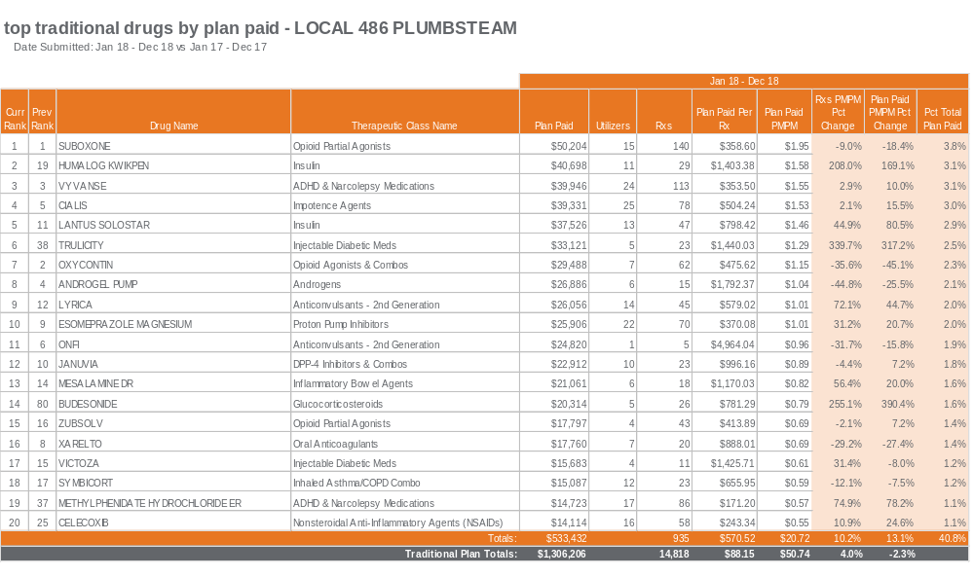

Slide 8
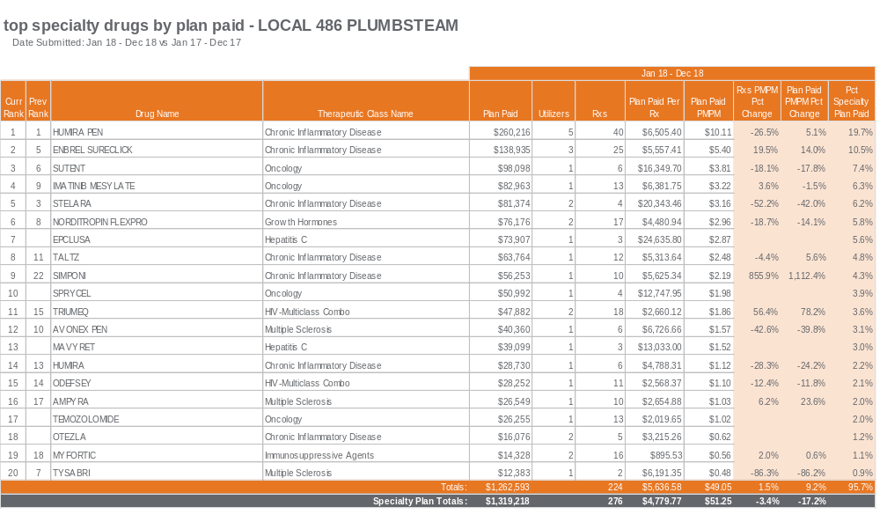

Slide 9
Clinical Opportunity/ Diabetes Management

Slide 10

Controlling diabetes
Reduces disease complications and overall health care costs
Patients with controlled diabetes may see a 10% decrease in costs²
People with diagnosed diabetes
Take more prescription drugs
Visit doctor offices and emergency
rooms more frequently¹
May also have cardiovascular, kidney or eye disease, cancer, obesity, hypertension, fractures
or amputations
People with controlled diabetes are more likely to:
Have fewer hospitalization
and emergency room visits
Adhere to medications
Regularly test blood glucose levels and participate in preventive screenings
Maintain a healthy lifestyle,
including diet and exercise
Average cost for diabetic members
is ~$17,000 per year¹
1. American Diabetes Association. Economic costs of diabetes in the U.S. in 2007. Diabetes Care 2018 May; 41(5): 917-928. https://doi.org/10.2337/dci18-0007; 2. Fitch K, Pyenson BS, Iwasaki K. Medical claim cost impact of improved diabetes control for Medicare and commercially insured patients with type 2 diabetes. J Manag Care Pharm. 2013 Oct;19(8):609-20, 620a-620d.
Confidential property of Optum. Do not distribute or reproduce without express permission from Optum.

Slide 11
OptumRx Diabetes Management Program
Addressing needs through an evidence-based approach
Engagement strategy varies by risk and aligns with ADA guidelines.
Lower-risk diabetics
need proactive care
High-risk diabetics
need higher-touch care
Predicts high-risk factors
Categorizes high vs. low risk
Machine learning model
All diabetic members
Educate
Diabetes
literacy
Monitor
Medication
adherence
Resolve
Close gaps
in care
Higher-risk members receive additional engagement
Connected Devices
Cloud meter and digital
Counseling
One-on-one
Providers
Engaged for
therapy changes
Incentives
Free supplies (no copay)
Confidential property of Optum. Do not distribute or reproduce without express permission from Optum.

Slide 12
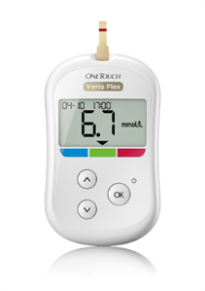

Diabetes Management Program
Connected care through $0 copay smart meters
Members with the Premium formulary receive a cloud-based OneTouch Verio® Flex meter and testing supplies.
Members receive a letter explaining how to get their meter and supplies.
Their doctor can provide a prescription for the meter and supplies.
The prescription can be filled at the pharmacy of their choice.
Members can call their Certified Diabetes Educator (CDE) for help getting started.
Meter testing results are shard via the OneTouch Reveal app or at www.onetouchreveal.com
OptumRx integrates testing data from the cloud-based meter into a member’s profile for enriched coaching.
Free cloud meter and diabetic supplies are optional and based on a client’s formulary.
Confidential property of Optum. Do not distribute or reproduce without express permission from Optum.

Slide 13
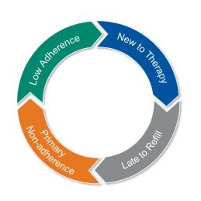

Medication adherence monitoring
For all diabetic members
Targets member and providers at key therapy points using multiple channels.
Member/provider outreach and OptumRx
pharmacist counseling
New to therapy
member education
Covers 18 medication classes
Asthma
Anticoagulants
Anticonvulsants
Antidepressants
Antiplatelet Agents
Antipsychotics
Antiretroviral
COPD Meds
Diabetes
Hep C
High Cholesterol
Hypertension
Inflammatory
Multiple Sclerosis
Osteoporosis Meds-bisphosphonates
Oral Oncology
Pulmonary
Hypertension Drugs
Transplant
  Provider outreach for
  not filling new Rx
Member IVR call connects members to their pharmacy
Confidential property of Optum. Do not distribute or reproduce without express permission from Optum.

Slide 14

One-on-one counseling
For high-risk diabetic members
Pharmacist Certified Diabetes Educators drive personalized consultations.
Diabetes education
Lifestyle, exercise and wellness tips
Automation drives better health outcomes
Compares A1C levels with standard medication ranges
Scans for gaps in care, safety and adherence across all diseases
Stores profile information for a complete member snapshot
Engages providers for clinical concerns
Captures A1C scores from cloud-based meter
Clinical assessment and medication review
Testing regimen
A1C scores captured
Action plan with member-specific goals
Personalized care and ongoing monitoring are key to improving diabetes health
Confidential property of Optum. Do not distribute or reproduce without express permission from Optum.

Slide 15

RDUR gaps in care
For all diabetic members
Identifies and closes gaps in medication therapy
Improves compliance and lowers health care costs
Helps treat chronic conditions like diabetes and cardiovascular disease
Identification
Retrospective review of member claims Identifies gap closure opportunities
Intervention
Provider intervention and provider-specific report Lists members and clinical rationale
Evaluation
Post-intervention evaluation via claim review Clinical issues resolved & total health care savings
Confidential property of Optum. Do not distribute or reproduce without express permission from Optum.

Slide 16


Diabetes Opportunity Analysis
Plumbers & Steamfitters Local 486
Date Submitted: Oct 1, 2018 -- Mar 31, 2019
High risk diabetic utilizers
have $1,334 higher annualized
plan paid than low
risk diabetic utilizers¹
Average Annual Pharmacy Plan Paid
5.9%
TOTAL DIABETIC UTILIZERS
DIABETIC UTILIZERS: 101
TOTAL UTILIZERS: 1,718
Pharmacy Utilizers
Pharmacy Plan Paid
2% of Pharmacy Utilizers filled a SGLT-2, GLP-1, or DPP-4
26% of Pharmacy Plan Paid attributed to diabetic members
¹Plan Paid difference of annualized Plan Paid for a High Risk Diabetic and Low Risk Diabetic Utilizer; High Risk is defined by pathway progression to a SGLT-2, GLP-1, or DPP-4 inhibitor.

Slide 17
Diabetes Opportunity Analysis
Plumbers & Steamfitters Local 486
Date Submitted: Oct 1, 2018 -- Mar 31, 2019
Diabetics in current period vs. prior period
9%
9% new diabetic utilizers
Changing diabetic regimen is defined as either adding a DPP-4, GLP-1, or SGLT-2 where one was not previously used or discontinuing these medications
*Unclassified indicates data not available for prior period
Diabetic member co-morbidities²
82.2%
DIABETICS WITH
COMORBIDITIES
of total Diabetics
²Pharmacy claims used as an indicator of disease. Drugs could be used for other purposes.

Slide 18

Diabetes Opportunity Analysis
Plumbers & Steamfitters Local 486
Date Submitted: Oct 1, 2018 -- Mar 31, 2019
High risk diabetes program engagement
Program components and annualized cost⁴
Counseling for enrolled high risk diabetic utilizers ($195 per enrolled member)
$780 - $1,365
Based on projected rate of adoption, 4 - 7 high risk diabetic utilizers are expected to enroll in the program.³
Gaps in care monitoring ($0.02 PMPM)
$671
Adherence monitoring ($0.06 PMPM)
$2,012
Total annual estimated costs
$3,462 - $4,047
Based on average monthly eligible members: 2,794
Contact your Account Management team to learn more about how the Diabetes Management program can help you improve the quality of care for your diabetic members.
³ Expected enrollment varies based on the assumption that 15-20% high risk diabetic utilizers will participate
⁴ Program costs are estimated and may vary based on enrollment of high risk diabetic utilizers

Slide 19



Copay Card Accumulator Adjustment Program

Slide 20





2018 BriovaRx initiatives
Copay Card Solutions
Preferred Copay Card
Acceptance Program
Copay Card Accumulator
Adjustment Program
Confidential property of Optum. Do not distribute or reproduce without express permission from Optum.
Notes:
Left side – 3 specialty copay card solutions
Variable copay – Set each individual copay depending on each of the manufact’s card maximum benefit. For example, if a member has a copay card valued at $1,000 per fill and a $100 copay based on the plan design, we can apply that extra $900 ‘leftover’ to the plan – thus saving an extra $900 on each fill.
Right side
Complete therapy solutions
We have expanded the disease categories targeted by BriovaLive and BriovaCommunity

Slide 21
Copay Cards Industry
$10B
Manufacturers spend on copay support programs in 2017
552
Copay assistance programs offered by 210 manufacturers for specialty drugs
42%
Of specialty prescriptions are filled with a copay support card
$
Pharmaceutical manufacturer copay support payments have been growing at double-digit rates
Some states are beginning to implement regulation against copay support programs to reduce drug cost
Pharmaceutical manufactures are beginning to offer alternate forms of assistance such as issuing debit cards & direct reimbursement
Employers are taking action to limit pharma sponsored copay support to contain prescription drug costs

Slide 22
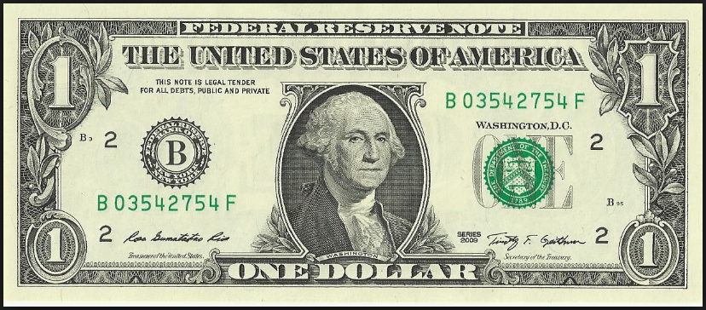

Accumulator
Real-Time Accumulator
Eligible coupons will be accepted, however, the coupon amount will not be applied toward a members’ deductible and out-of-pocket maximum.
$100 Copay
Amount Applied to Deductible & OOP
Today | Jan. 1, 2017
$100 | $10
Cost share + copay card | Cost share only
$10 Member Pays
$90 Copay Card
Notes:
Note: The Accumulator solution will provide options: the amount not added to accumulators can apply to both the deductible and MOOP or Just the MOOP.
Also the amount not added to the accumulator can extent beyond manufacturer copay card coupons, to address all secondary and all tertiary coverages.

Slide 23
Preferred Copay Card Acceptance Program

Slide 24
Preferred Copay Card Acceptance Program
The OptumRx Preferred Copay Card Acceptance (PCCA) Program encourages the use of preferred lower cost drug options through
restricting the use of non-accepted copay cards.
Accepted
Copay Cards
Non-Accepted
Copay Cards
250+
~40
Aligns with high value strategy
Lower cost options available
Note: Manufacturer copay cards are different from non-profit organization/means-based patient assistance programs. Members can continue to work directly with these organizations to receive assistance.
Notes:
Most cards are accepted, but when there are clearly other lower cost clinically viable options available, the program will not accept a copay card when these conditions apply.
Note: Because some members may not choose the preferred drug option and may seek reimbursement directly through the manufacturer, we cannot precisely measure the impact of the Preferred copay Card Acceptance program. However, it does place the administrative responsibility on the manufacturer.

Slide 25
PCCA Value Story
savings
annual estimate per
utilizing member
$16,000
$35,000
Annual assumes twelve monthly treatments

Slide 26
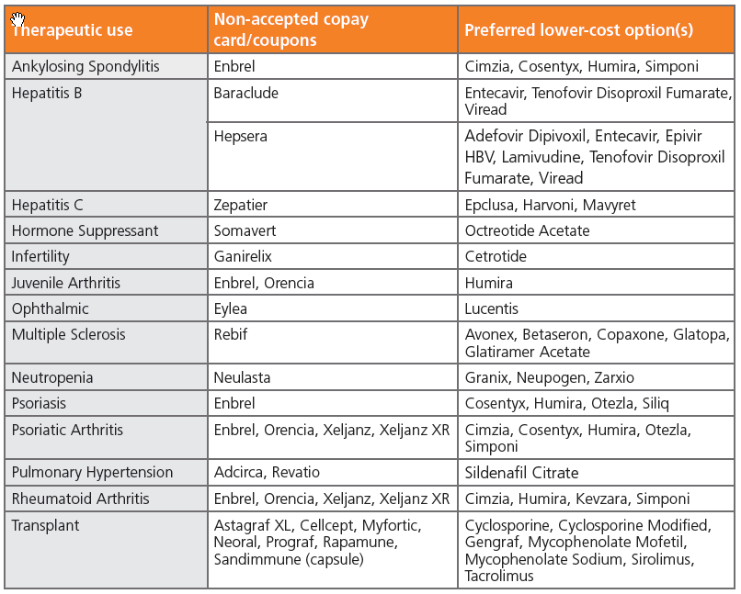
Non-accepted Copay Cards/Preferred Options
Notes:
42 drugs total.
Some preferred drugs are in the same therapeutic class, and there are in some cases, more than one preferred drug option.

Slide 27
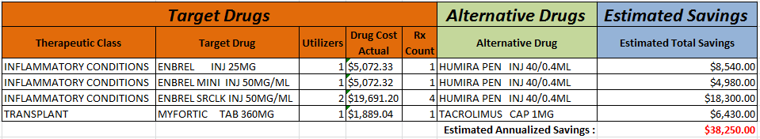
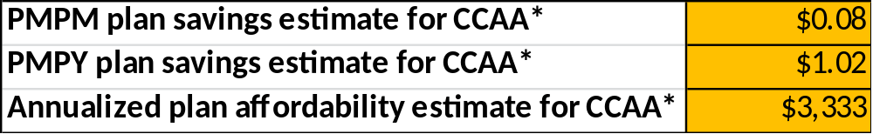

PCCA Potential Program Savings
CCAA Potential Program Savings

Slide 28
Questions?

Slide 29
9. Appendix

Slide 30
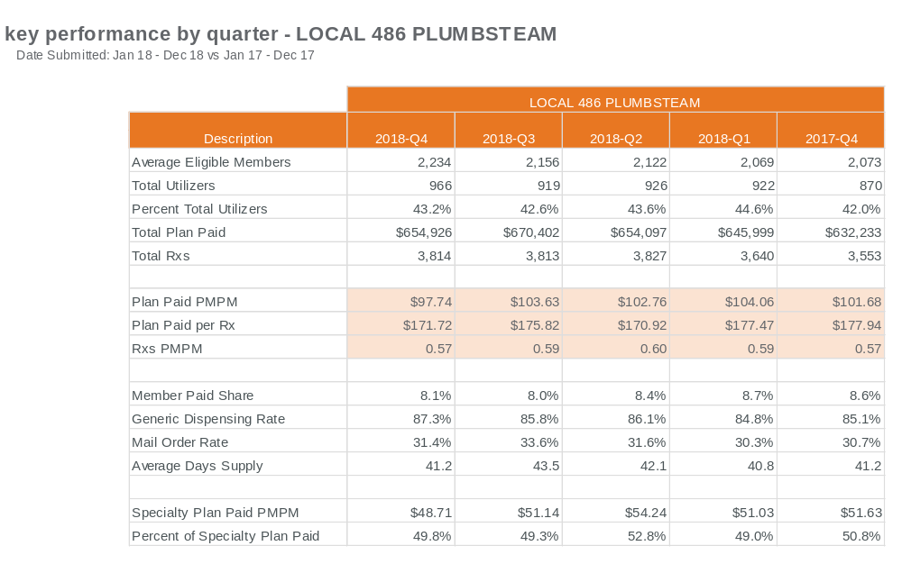

Slide 31
